Slide 1
Threads in Java
By
A.Harish

Slide 2
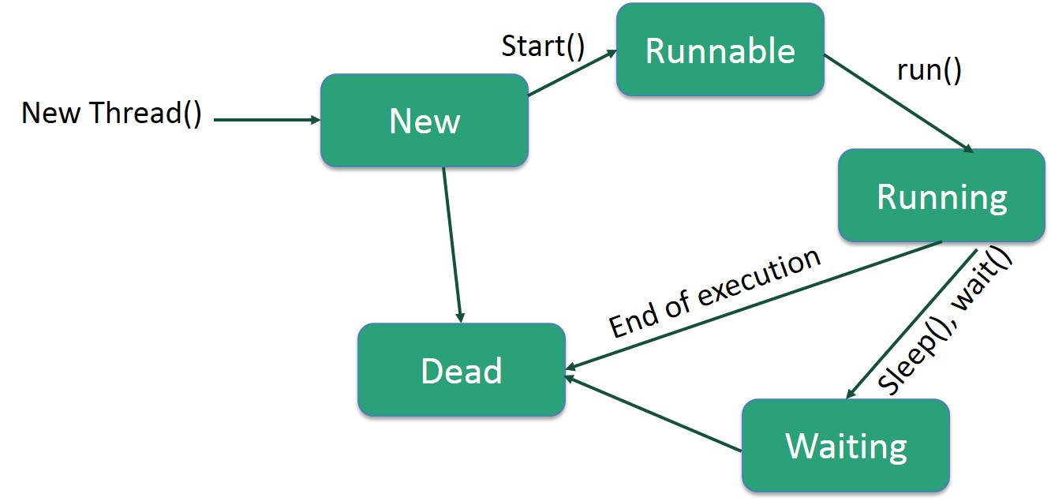

Slide 3
Method | Meaning
getName() | Obtain a thread’s name.
getPriority() | Obtain a thread’s priority.
isAlive() | Determine if a thread is still running.
join() | Wait for a thread to terminate.
run() | Entry point for the thread.
sleep() | Suspend a thread for a period of time.
start() | Start a thread by calling its run method.

